Slide 1
24/02/2022
Title: First and second law
Aims:
Know and be able to use the second law of indices.
Plan:
Daily review:
Index Law #1.
Index Law #2

Slide 2
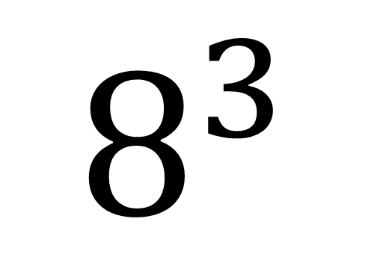
The index number (or exponent, indices or power)
How many of the Base number we need in the multiplication
The BASE number (BIG IS BASE)
It is the number that is repeated in the multiplication.
$$8^{3}$$
= 8 x 8 x 8

Slide 3
First Law of Indices
If index terms with the same base are multiplied together then the powers can be added.
$$a^{m}× a^{n}=a^{m+n}$$
Examples:
$2^{3}× 2^{4}$
$=2^{3+4}$
= $2^{7}$
${ (−3)}^{4} × {(−3)}^{6}$
= ${(−3)}^{4+6}$
= ${(−3)}^{10}$
$2^{3}× 5^{2}×2^{4}×5^{6}$
$=2^{3+4}×5^{2+6}$
= $2^{7}× 5^{8}$

Slide 4
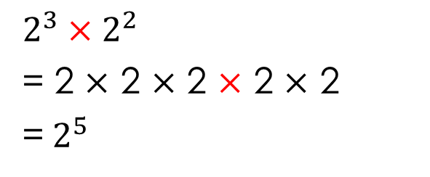
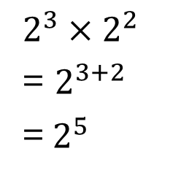
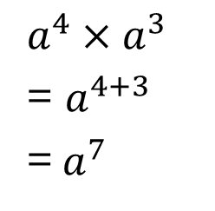
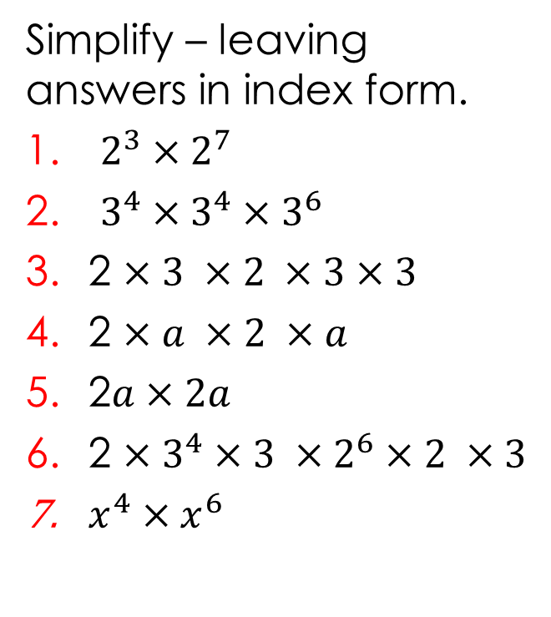
Simplifying expressions using indices - multiplication.
$2^{3}×2^{2}$
= 2 $×$ 2 $×$ 2 $×$ 2 $×$ 2
=${ 2}^{5}$
$2^{3}×2^{2}$
= $2^{3+2}$
=${ 2}^{5}$
$a^{4}×a^{3}$
= $a^{4+3}$
=${ a}^{7}$
Simplify – leaving answers in index form.
$2^{3}×2^{7}$
$3^{4}×3^{4}×3^{6}$
2 $×3 ×2 ×3×3$
2 $×a ×2 ×a$
2$a×2a$
2 $×3^{4}×3 ×2^{6}×2 ×3$
$x^{4}×x^{6}$

Slide 5

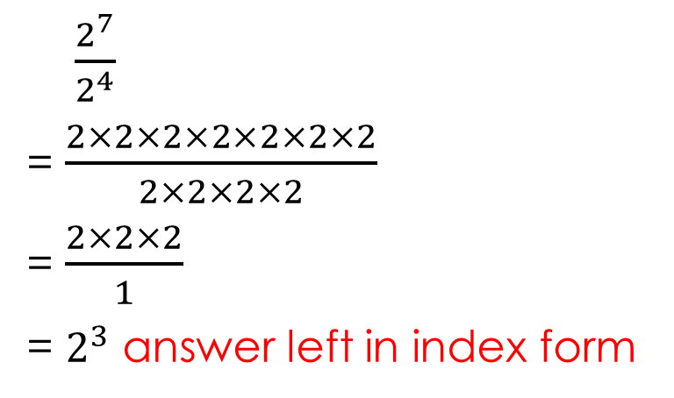

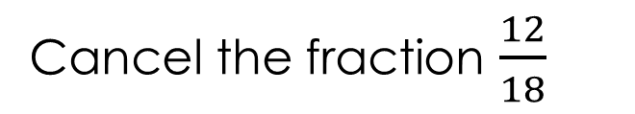
Whiteboards:
Simplifying expressions using indices - division.
Cancel the fraction $\frac{12}{18}$
$\frac{12}{18}$
= $\frac{2×2×3}{2×3×3}$
= $\frac{2}{3}$
$\frac{2^{7}}{2^{4}}$
= $\frac{2×2×2×2×2×2×2}{2×2×2×2}$
= $\frac{2×2×2}{1}$
= $2^{3}$ answer left in index form
$\frac{2^{7}}{2^{4}}$
= $2^{7−4}$
= $2^{3}$

Slide 6
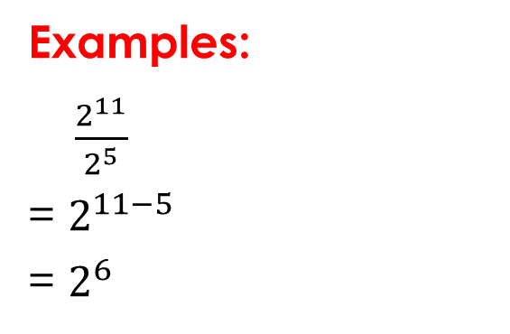
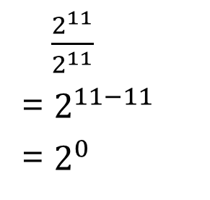
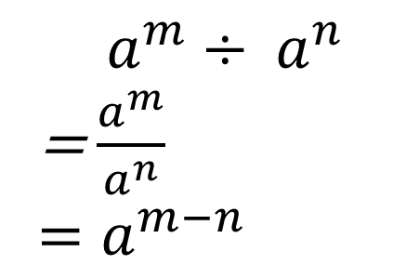
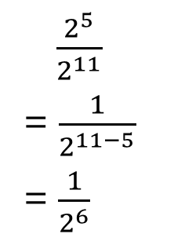
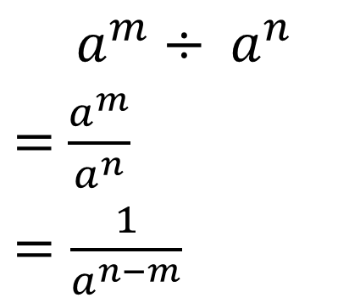

Second Law of Indices
If index terms with the same base are divided then the powers can be subtracted.
$a^{m}÷ a^{n}$
= $\frac{a^{m}}{a^{n}}$
$=a^{m−n}$
$a^{m}÷ a^{n}$
$=$ $\frac{a^{m}}{a^{n}}$
$=\frac{1}{a^{n−m}}$
or
Examples:
$\frac{2^{11}}{2^{5}}$
= $2^{11−5}$
= $2^{6}$
$\frac{2^{5}}{2^{11}}$
= $2^{5−11}$
= $2^{−6}$
$\frac{2^{5}}{2^{11}}$
= $\frac{1}{2^{11−5}}$
= $\frac{1}{2^{6}}$
$\frac{2^{11}}{2^{11}}$
= $2^{11−11}$
= $2^{0}$
or

Slide 7
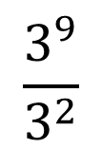
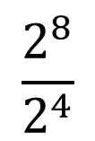
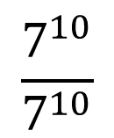
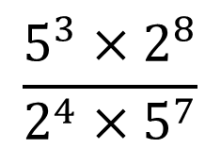
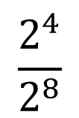
White-boards
Simplify
$$\frac{2^{8}}{2^{4}}$$
$$\frac{3^{9}}{3^{2}}$$
$$\frac{2^{4}}{2^{8}}$$
$$\frac{{5^{3}×2}^{8}}{2^{4}×5^{7}}$$
$$\frac{7^{10}}{7^{10}}$$

Slide 8

Copy and complete in exercise books.
Simplify – leaving answers in index form.
$\frac{2^{10}}{2^{4}}$
$\frac{2^{4}}{2^{10}}$
$\frac{x^{12}}{x^{7}}$
$\frac{5^{2}{× 3}^{5}}{3^{2}×{ 5}^{6}}$
$\frac{2×3^{4}×5^{3}}{2 ×5 ×3 ×3}$

Slide 9
Individual practice
Complete the task sheet from yesterday.

